Slide 1
The weather search
왕디청

Slide 2
1.Access to regional information
To make such a weather forecast app, you first need to get a list of domestic regions
Chinese weather net open interface with weather forecast, access to "http://www.weather.com.cn/data/list3/city.xml" can obtain a list to domestic provinces and its code
If you want to obtain a list of guangdong province under the city, by above knowable, code-named 28 in guangdong province, the interface address is "http://www.weather.com.cn/data/list3/city28.xml", access to the list of cities and the code is as follows:
You can also get more detailed regional information by analogy, which completes the beginning

Slide 3
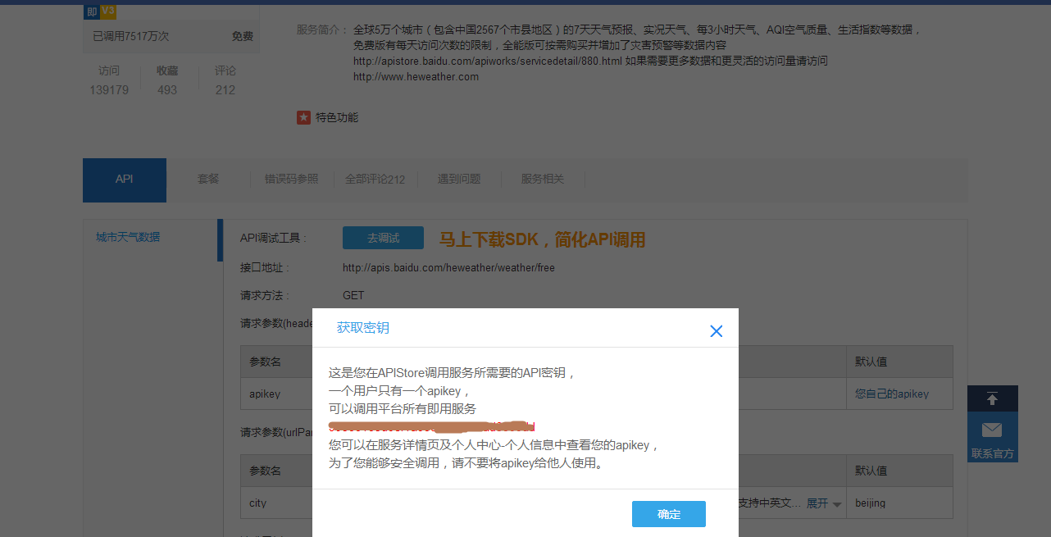
2.Access to weather information
Baidu's APIStore has a rich interface that covers many aspects of life. For example, we can get JSON data containing weather information through an APIStore interface, thus realizing weather forecasting
First, users must have a baidu account and then log on to the following website: China and world weather forecast
The interface is free, but therefore not stable enough, and I often make mistakes when debugging
Then click "your own apikey" under the API option to view your own apikey. This value is the only identifier for each developer and app, and it needs to be properly preserved so tThe weather information obtained is in JSON format and needs to be parsed in the program
hat the apikey can be used for the next step

Slide 4
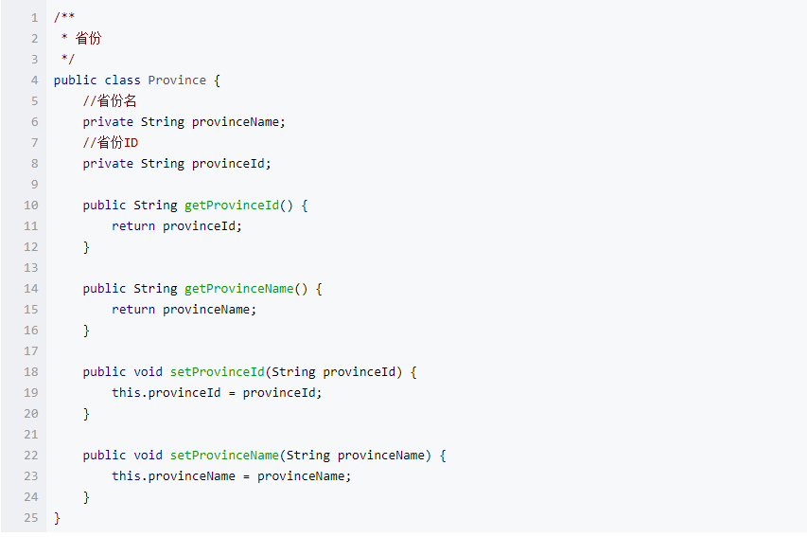
3.Database design
The information in the area list is usually fixed, so we can store the data obtained from the first network into the database and read it from the database the next time we access it
The first is to set up four models, including: provinces, cities, counties and hourly weather forecasts, to carry data
Each Model includes several attributes and corresponding get and set methods
For example, the design of the Province Province Province is shown as follows. The design of the City and County is similar

Slide 5
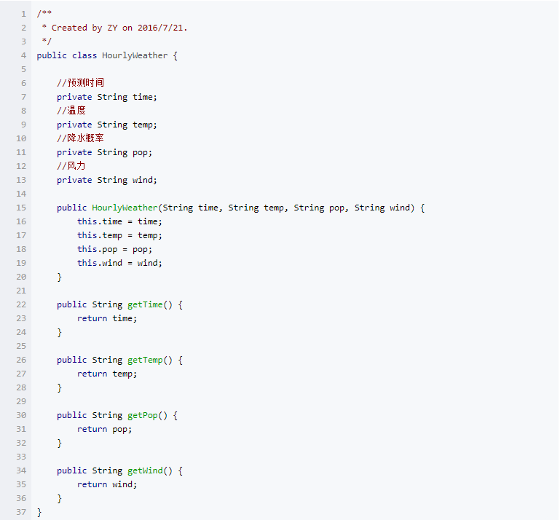
HourlyWeather is designed as follows:

Slide 6
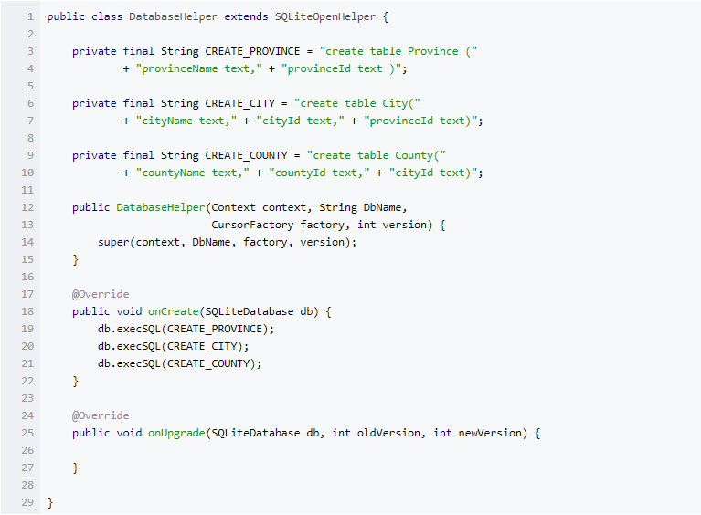
Then, create a new DatabaseHelper class that inherits from SQLiteOpenHelper to create three database tables

Slide 7
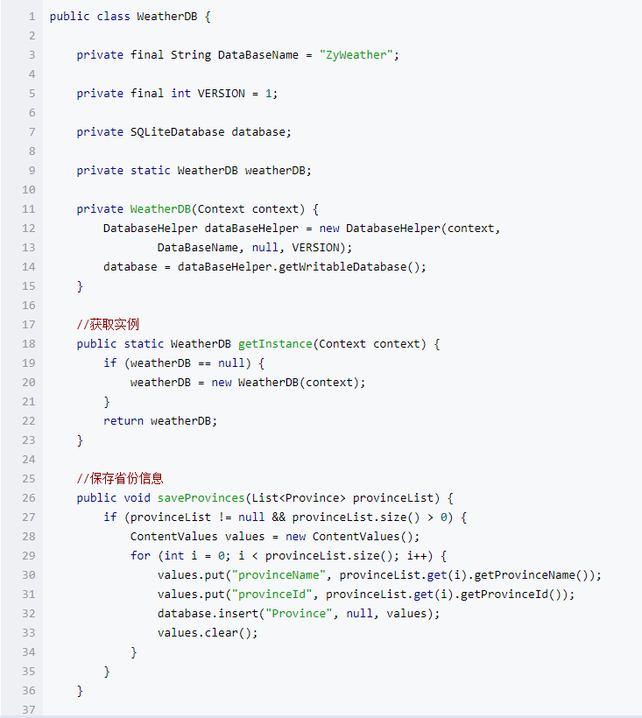
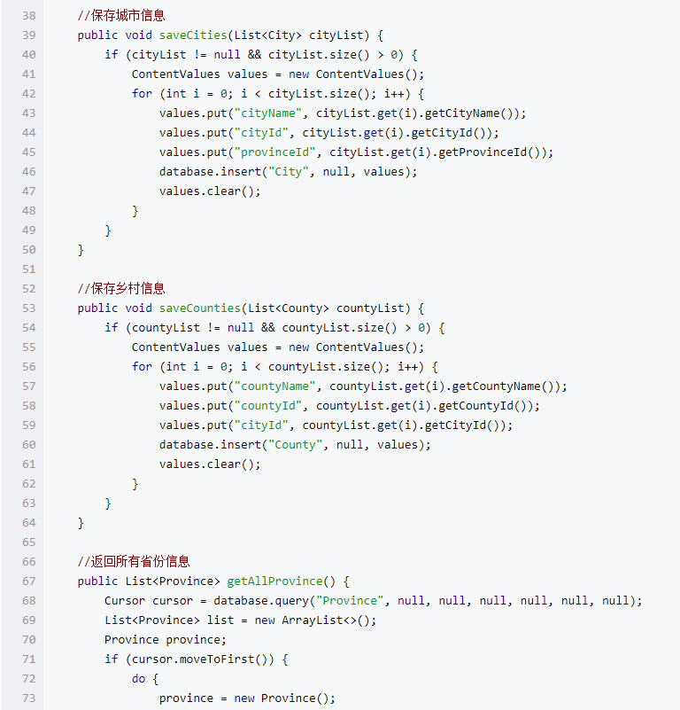
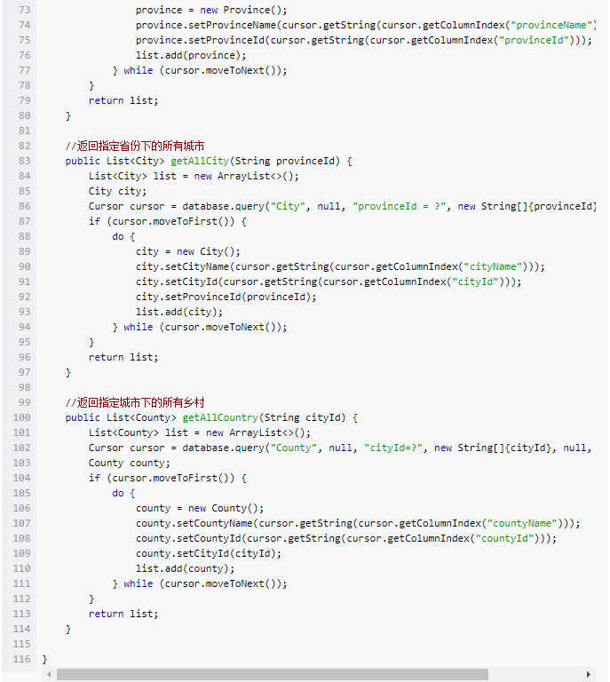
Then, a WeatherDB class is created to perform actual database operations, including access to province information, city information, county information, and so on
It is important to note that since each city is contained within a province, querying the list of all cities within a province requires that the ID of the province be passed in as a unique identifier

Slide 8
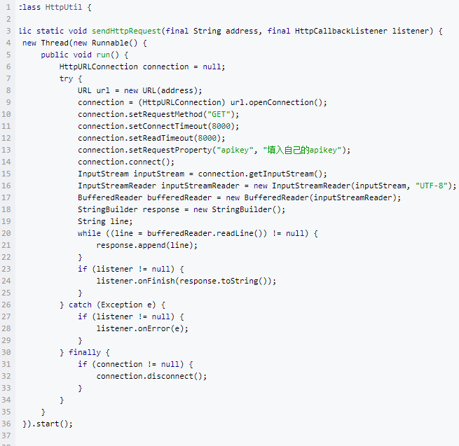
4. Network operation
The entire app USES the same function to perform various data operations, which is included in the HttpUtil class as a static function
I need to fill in the apikey I applied for. This key is only useful for getting weather information, but it is not necessary for obtaining regional information

Slide 9
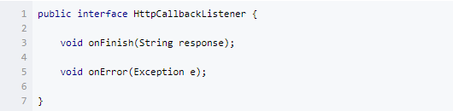
5. Tools
After network access data is successful or fails, data processing needs to be done by callback method, so an interface HttpCallbackListener needs to be set
In addition, using the HttpUtil after class to regional information, because the data contains some separators, not directly deposited in the database, and also the JSON format to weather information, also requires data parsing, so you also need to have a Utility class used for data processing

Slide 10
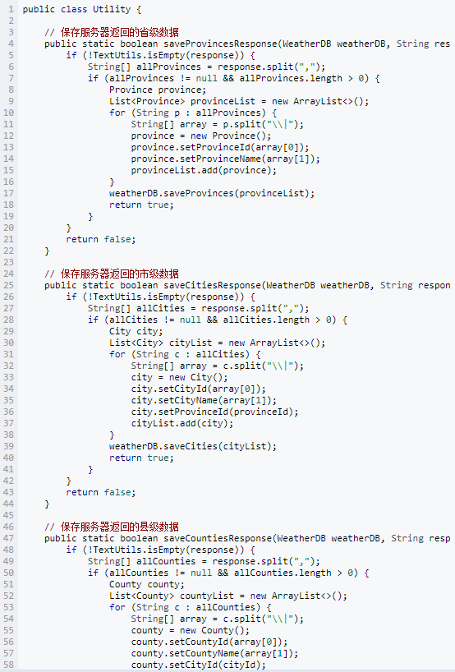
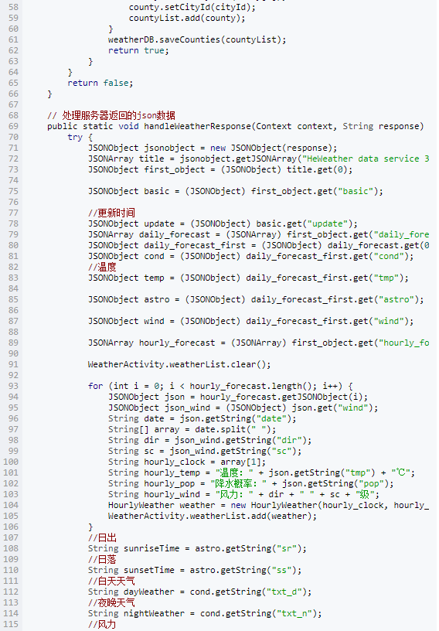
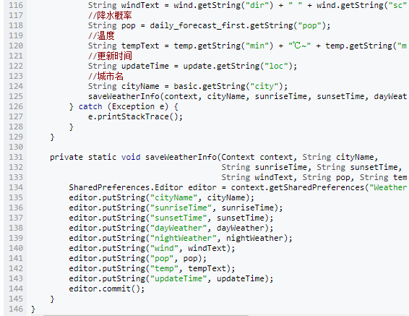
In addition, using the HttpUtil after class to regional information, because the data contains some separators, not directly deposited in the database, and also the JSON format to weather information, also requires data parsing, so you also need to have a Utility class used for data processing

Slide 11
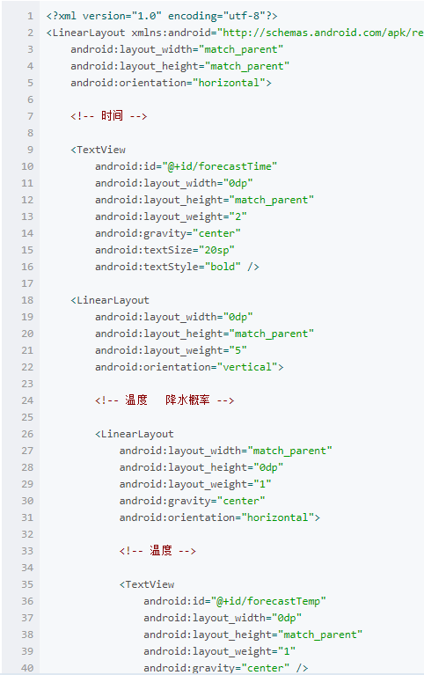
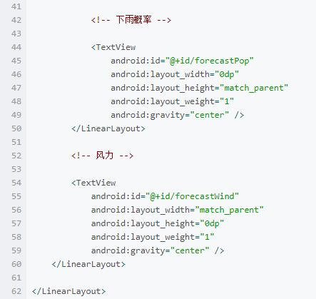
6. The adapter
The above dynamic diagram shows hourly weather prediction information, which is rendered using the ListView, which provides an adapter for it
The layout file used by ListView is as follows:

Slide 12
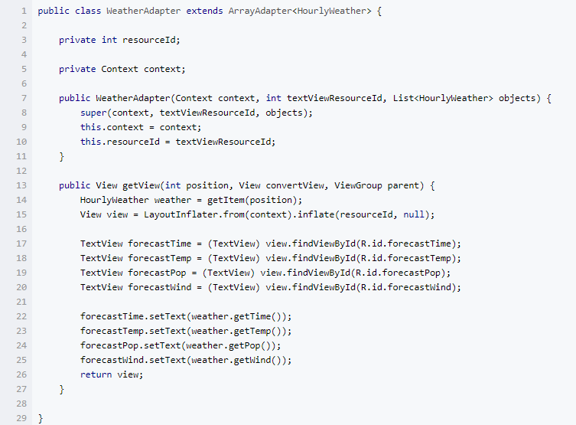
Then create a new WeatherAdapter that inherits from the ArrayAdapter< HourlyWeather>
Just override the getView(int position, View convertView, View group parent) method

Slide 13
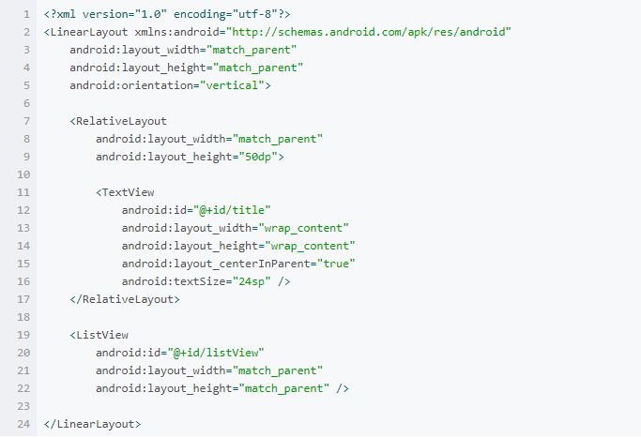
7. The Activity of the writing
The first step is to complete the regional selection interface ChooseAreaActivity
The interface of ChooseAreaActivity consists of a middle TextView and a ListView
The layout file is as follows:

Slide 14
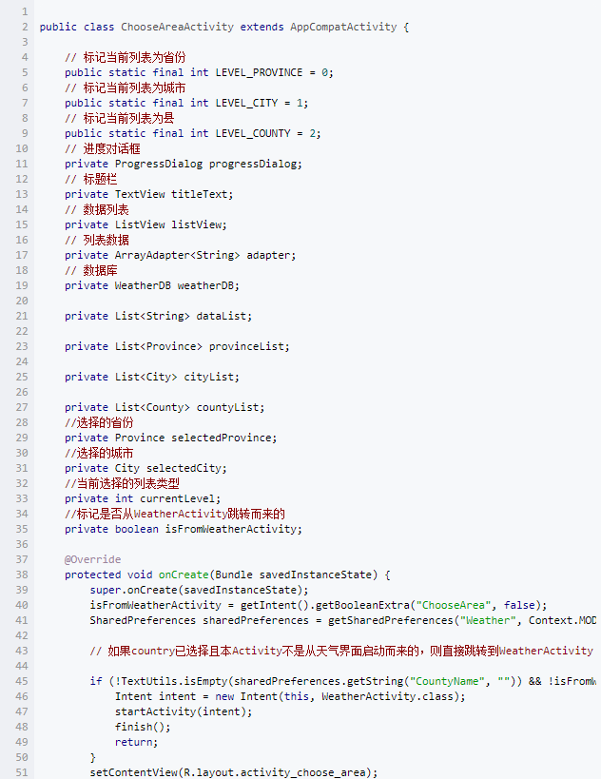
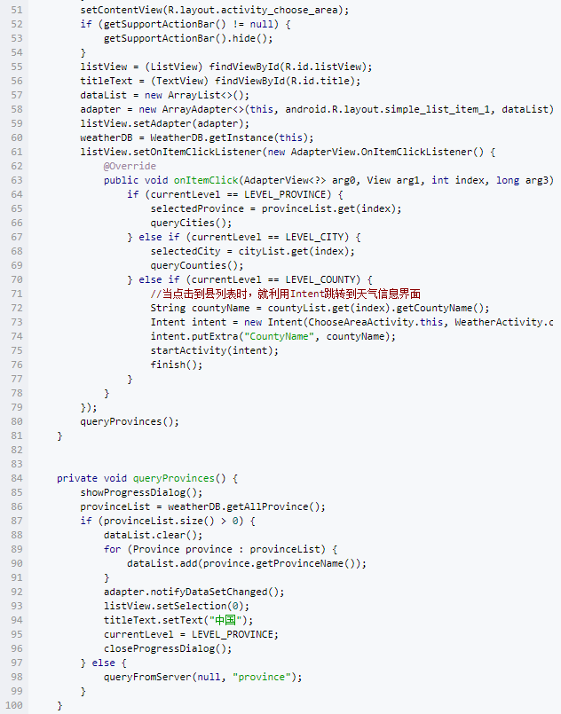
ChooseAreaActivity needs to complete the loading of the list of regions, passing the selected County name to WeatherActivity
In addition, showProgressDialog() is used to render a progress dialog box, also set to fail to close by the return key

Slide 15
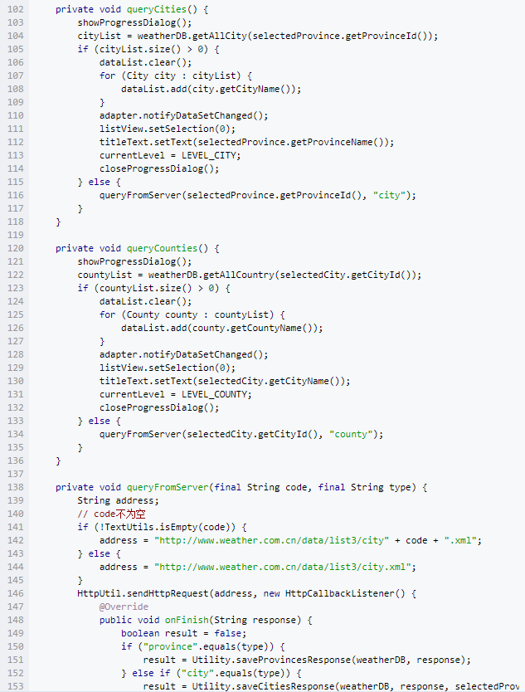
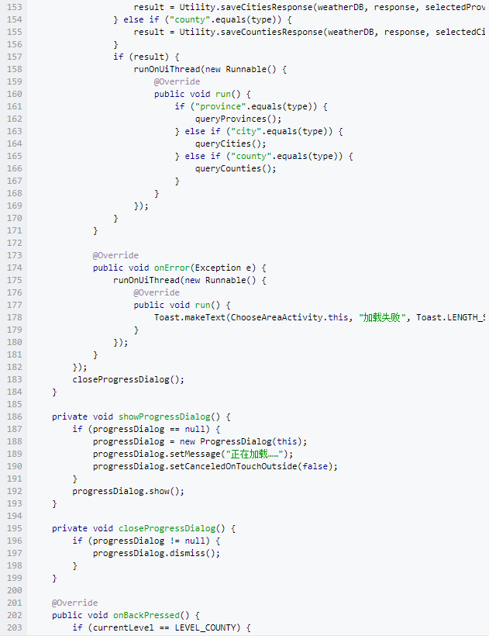
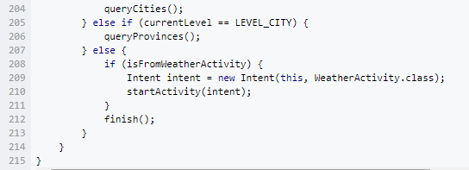

Slide 16
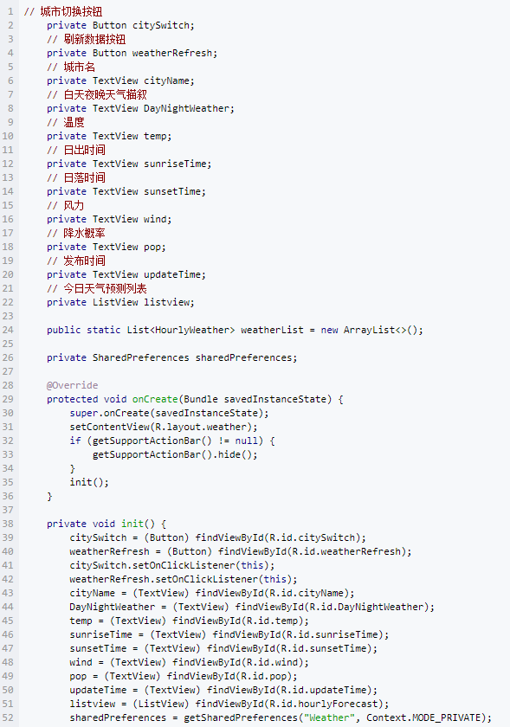
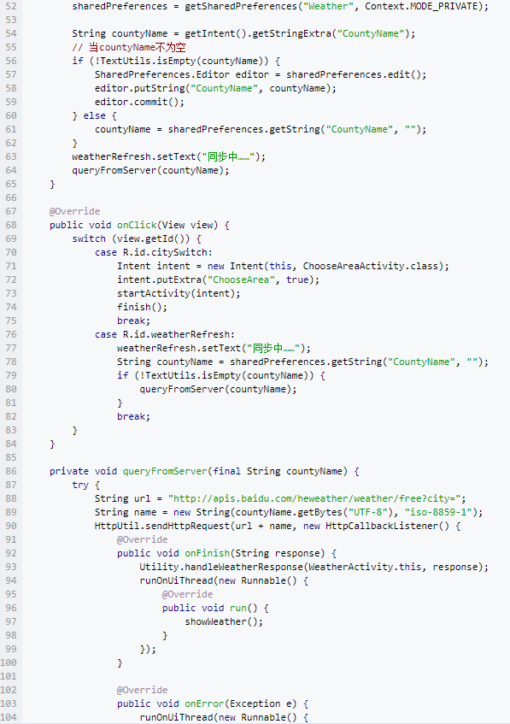
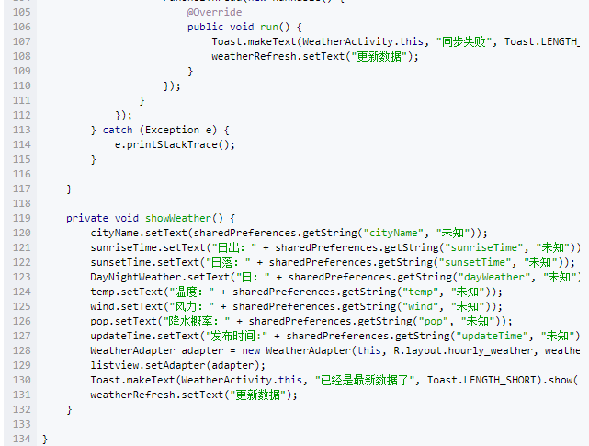
WeatherActivity's layout is relatively complex, containing many textviews that simply render the data in text

